Slide 1
Alton, Illinois
Crime Free Multi-Housing
Notes:
Darkened picture background with full-color circle
(Intermediate)
Tip: For best results with the picture overlay on this slide, use a picture that is the same dimensions as the slide: 10” wide and 7.5” high. If the picture is not the same width and height, resize or crop to those dimensions before following the instructions below.
To reproduce the background effects on this slide, do the following:
On the Home tab, in the Slides group, click Layout, and then click Blank.
Right-click the slide and then click Format Background.
In the Format Background dialog box, click Fill in the left pane. In the Fill pane, select Picture or texture fill, and then under Insert from, click File.
In the Insert Picture dialog box, select a picture, and then click Insert.
Also in the Format Background dialog box, click Picture in the left pane, and then do the following in the Picture pane:
Click the button next to Recolor, and then under Color Modes, click Grayscale (first option from the left).
In the Brightness box, enter -50%.
In the Contrast box, enter -60%.
On the Insert tab, in the Images group, click Picture.
In the Insert Picture dialog box, select the same picture used for the background, and then click Insert.
On the Home tab, in the Drawing group, click Shape Effects, point to Soft Edges, and then click 10 Point.
Under Picture Tools, on the Format tab, in the Size group, click the down arrow under Crop, click Crop to Shape, and then under Basic Shapes, click Oval (first row, first option from the left).
Select the oval. Under Picture Tools, on the Format tab, in the bottom right corner of the Size group, click the Size and Position dialog box launcher. In the Size and Position dialog box, on the Size tab, under Crop from, enter values into the Left, Right, Top, and Bottom boxes to crop the oval as needed.

Slide 2
Welcome!
Please select a seat where documents have been prepared for you. Please wait for instructions to fill out your registration form.
Please be sure to turn your cell phones on vibrate.
Please ask if there is anything the Alton Police Department can do to assist you.
Bathrooms are outside this room and down the hallway.

Slide 3
Disclaimer:
While we will address legal information in general, the Law deals with “specific facts” presented in each situation. The information presented here should NOT be relied upon as a substitute for legal advice.
ALWAYS CONSULT WITH AN ATTORNEY.

Slide 4

CFMH originated in Mesa, AZ in 1992
New concept for crime prevention in rental communities
A program that had no precedent
Unique coalition of police, property managers, and residents of rental properties
Development of the Crime Free lease addendum – the backbone of the program

Slide 5

CFMH spread to nearly 2000 cities in 48 states
International crime free programs:
  5 Canadian Provinces
  Mexico
  England
  Finland
  Japan
  Russia
  Malaysia
  Nigeria
  Afghanistan
  Puerto Rico

Slide 6
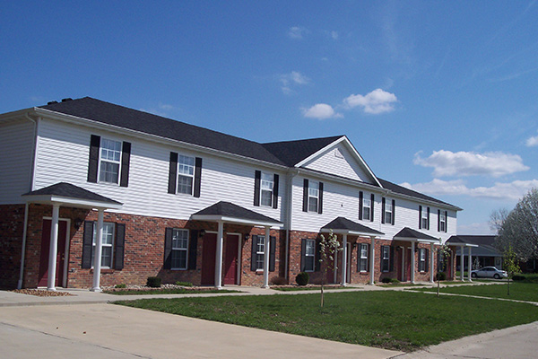
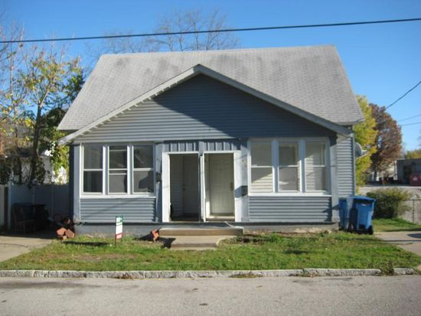
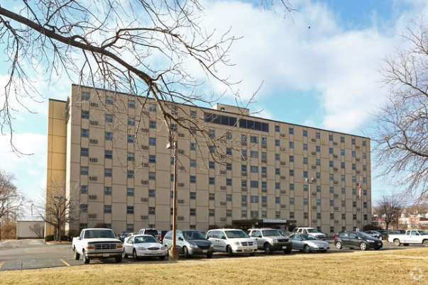
What is Multi-Housing?
Multi-Housing is any rental property with one or more dwelling units

Slide 7
The Crime Free Housing Program has been successfully applied to single family home rentals

Slide 8
Other Towns Doing Crime Free
Collinsville
Fairview Heights
Granite City
Belleville
O’Fallon
Swansea
Schaumburg
Mount Prospect
Wheeling
Des Plaines
Rosemont
Oak Forest
Alsip
Addison
Hazelcrest
Glendale Heights
Tinley Park
Park Forest
Carpentersville
Riverdale
Elgin
Naperville
Chicago Heights
Forest Park
Rockford
Homewood
Aurora

Slide 9
Ordinance Requirements
Attend and complete the seminar
All new property managers must be trained within 3 months of hire
  Turn in signed registration form
  Adopt a Crime Free Lease Addendum
    Addendums are available during the seminar
  Lease addendum must be utilized with all future leases
  All reference information in this presentation can be found at
  www.cityofaltonil.com

Slide 10

Crime Free Addendum
Must provide Building and Zoning a copy of the lease addendum, including the certificate of occupancy listing all tenants and all household members
Must be signed every year by everyone on the property 18 years of age or older when the lease is renewed

Slide 11
ALTON CRIME FREE MULTI-HOUSING PROGRAM
Keeping Illegal Activity Out of Rental Property

Slide 12
Why are YOU here?
Rise in crime in rental properties?
Shift in the criminal mindset?
Investment properties?
  The process in which a neighborhood is transformed from low-value to high-value properties
  The phenomenon of a formally industrial or dilapidated area becoming attractive to middle classes through improved services, access or a perception of “trendiness”

Slide 13
2018 Crime Statistics
Percentages of Crime Committed at a Rental Property
90% of Homicides
64% of Drug Offenses
56.3% of Burglaries
72.7% of Home Invasions
75% of Batteries
74% of Aggravated Batteries
70% of Sexual Assaults
54.5% of Armed Robberies
50% of Arson cases
100% of Attempted Murder cases
100% of Vehicular Hijacking cases
60% of Offenses Related to Motor Vehicles

Slide 14
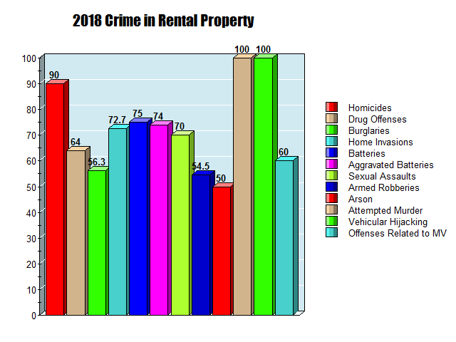

Slide 15
Bottom Line?
72.2% of all major violent crimes committed in Alton in the year 2018 was committed at a rental property

Slide 16

Criminals Prefer Rentals
They are often very transitory in nature
They want to BLEND into a larger crowd
Asset-Forfeiture Laws do not generally apply
If necessary, they can move away quickly

Slide 17
CFMH Program Goals
Empower community leaders
Train in management skills – NOT police work!
Provide support avenues
Reduce crime in rental property
Reduce the fear of crime
Improve communication
Build trust
Improve quality of life in neighborhoods
Stabilize property values

Slide 18
TO BUILD TRUST, YOU NEED:
Increased Contact
TRUST
Visible Improvements
Shared Information
(with police and with each other)

Slide 19

ALTON CRIME FREE MULTI-HOUSING PROGRAM
Part One: Crime Prevention

Slide 20

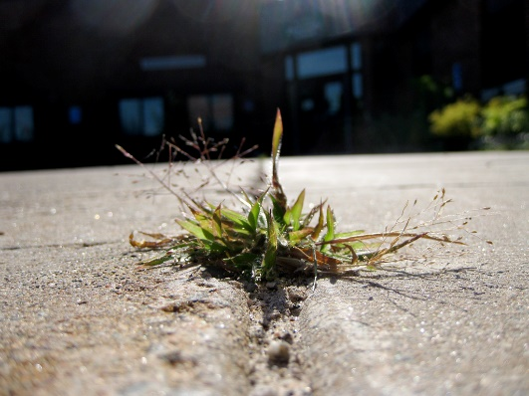
We view criminals like weeds…
They GROW
They ROOT
They SPROUT OUT
They SPREAD OUT
They CHOKE OUT the good plants!
Criminals are just like weeds – they will get bigger and stronger with each new success!

Slide 21
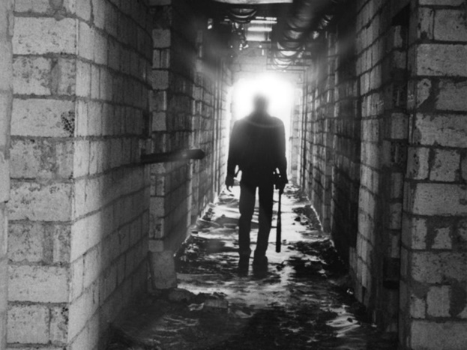

To understand crime…
You need to understand the “criminal” mindset
Criminals are PREDATORS!
They sometimes stalk their prey
They look for the easy victim

Slide 22

Most criminals look for:
The path of least resistance
The easy target
The unaware
The fearful
HOW DO WE FIGHT IT?

Slide 23

RISK MANAGEMENT
How You Manage the Risk of a Loss
Risk Avoidance
Risk Reduction
Risk Transference
Risk Spreading
Risk Acceptance

Slide 24
RISK AVOIDANCE
(No measurable cost)
Avoid the risk completely by changing or terminating all activities vulnerable to risk
  Auto Theft
  Armed Robbery

Slide 25
RISK REDUCTION
(No measurable cost)
Reduce the risk
  Lock Doors
  Roll Up Windows
  Remove Valuables

Slide 26
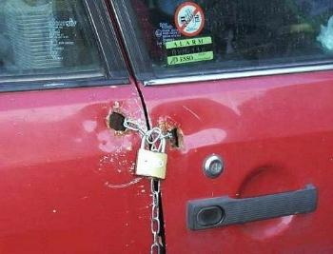

Slide 27
RISK TRANSFERENCE
(Spend a little money now to save a lot of money later)
Insurance
Money Safes
Courier Services
Pull-Out Car Stereos
Vehicle Security Devices

Slide 28
RISK SPREADING
(No measurable cost)
Spread your risk around
  Money or valuables
  Many hiding places

Slide 29
RISK ACCEPTANCE
(Costs nothing - - DO nothing)
Accept the risks
Take your chances
THIS IS NOT GOOD BUSINESS SENSE!
*Remember, if you accept risk, you must also accept the liability of risk

Slide 30

Premise Liability:
Foreseeability
  Knew about (or SHOULD have known about)
  Prior similar acts
  Lack of care
  Standards and practice

Slide 31
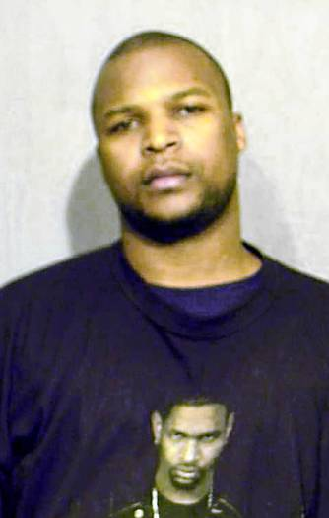
WHO is Liable?
Anthony Triplett – Cable Repairman
Charged with the 2006 rape and murder of Urszula Sakowska (Chicago)
Was fixing her internet service
Was already a suspect in the rape and murder of Janice Ordidge (Hyde Park)
Was fixing her internet service
Comcast and Premier Cable Communications were notified by police that he was a suspect but they continued to employ him
Chicago Tribune (4.30.2013)

Slide 32
A Combined Effort
POLICE
CRIME
MANAGEMENT
RESIDENTS

Slide 33

How Can You Predict Who Will Be a Criminal?
Best way to predict ‘FUTURE’ desire to do criminal activity?
  Look into their PAST
  Thorough screening
  Proper orientation to the Crime Free Program

Slide 34
Who has the POWER?
The police can arrest, but the offenders are usually released immediately
They are not afraid of the police or the courts
Only the landlord or their agent(s) have the authority to remove the tenant permanently from the property
*We have more impact on them civilly than criminally*

Slide 35

The City of Alton is about 17 square miles. The population in Alton is just shy of 27,000 people. Early reports put the number of rental units in Alton alone at 3,200.
How many police officers do you think are employed with the City of Alton?

Slide 36

Alton currently has 61 officers
How many officers do you think patrol the streets of Alton at one time?

Slide 37

With only 4-7 squads on the street, the police need the public’s help.

Slide 38

ALTON CRIME FREE MULTI-HOUSING PROGRAM
Part Two: The Three Phases

Slide 39

Phase One
Eight Hours of Training
(Conveniently condensed into four hours)

Slide 40
Training Topics in the Seminar
Crime Prevention Orientation
Elements to Certification
C.P.T.E.D. (Safe by Design)
Applicant Screening
Combating Illegal Activity
Community Rules and Leases
Partnership with the Police
Dealing with Non-Compliance

Slide 41

Phase Two
On-Site Property Inspection

Slide 42

Mandatory C.P.T.E.D. Requirements:
Deadbolts
Eye Viewers (180-190)
Security strikeplates
Anti-Slide/Anti-Lift windows and sliding glass doors
Adequate lighting
Proper landscaping

Slide 43

Phase Three
C.P.T.E.D.

Slide 44
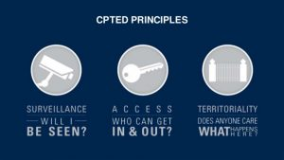
C.P.T.E.D.
Four Key Elements:
  Surveillance
  Access Control
  Territoriality
  Activity Support

Slide 45
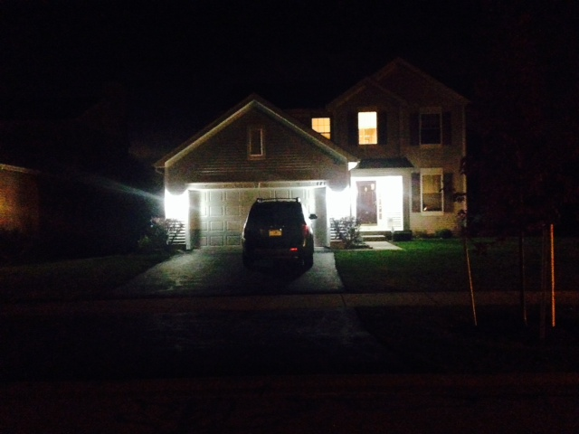
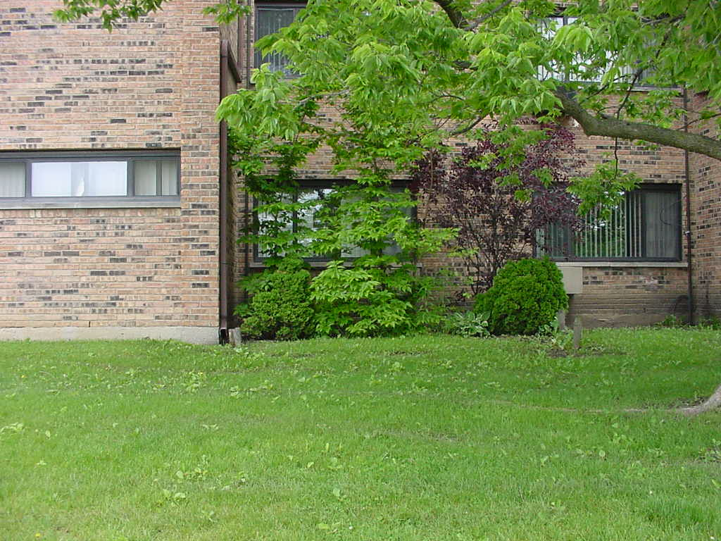
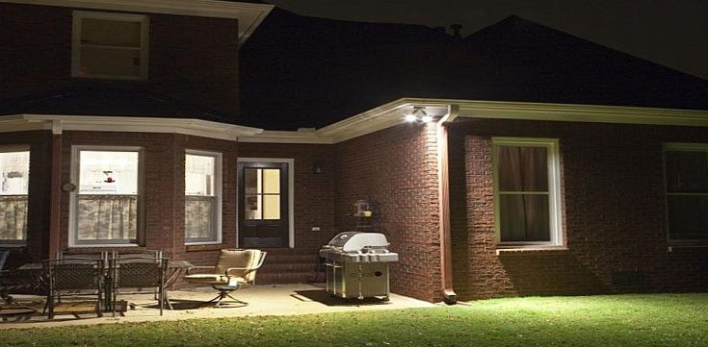
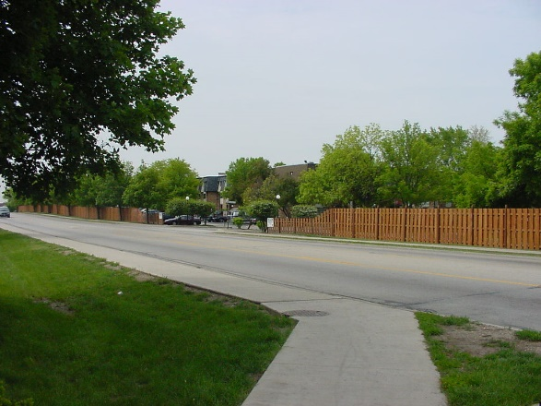
SURVEILLA NCE:
The ability to look into or out of an area
Three Types of Surveillance
  Natural – naturally occurring (can be FORMAL or INFORMAL)
  Mechanical – using an item (or device) that is designed to enhance visibility
  Organized – conducted by an organized group or individuals

Slide 46
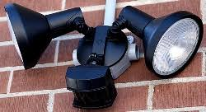
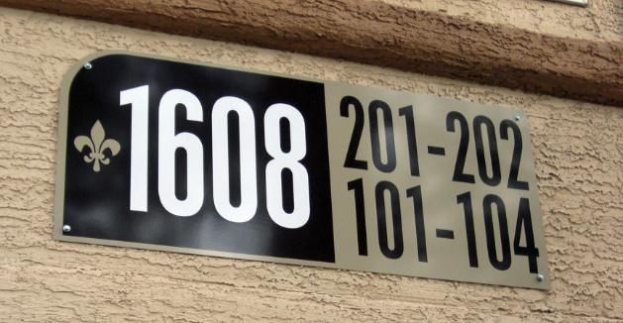
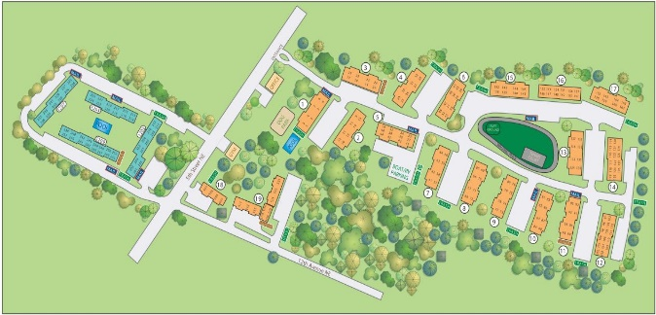
Preparing the Property
Begins at ‘blueprint’ stage
Use lighting to your advantage
Post addresses/building numbers
Post a map at multiple entrances

Slide 47

Access Control:
Limit Access
Deny Access
Control Movement

Slide 48

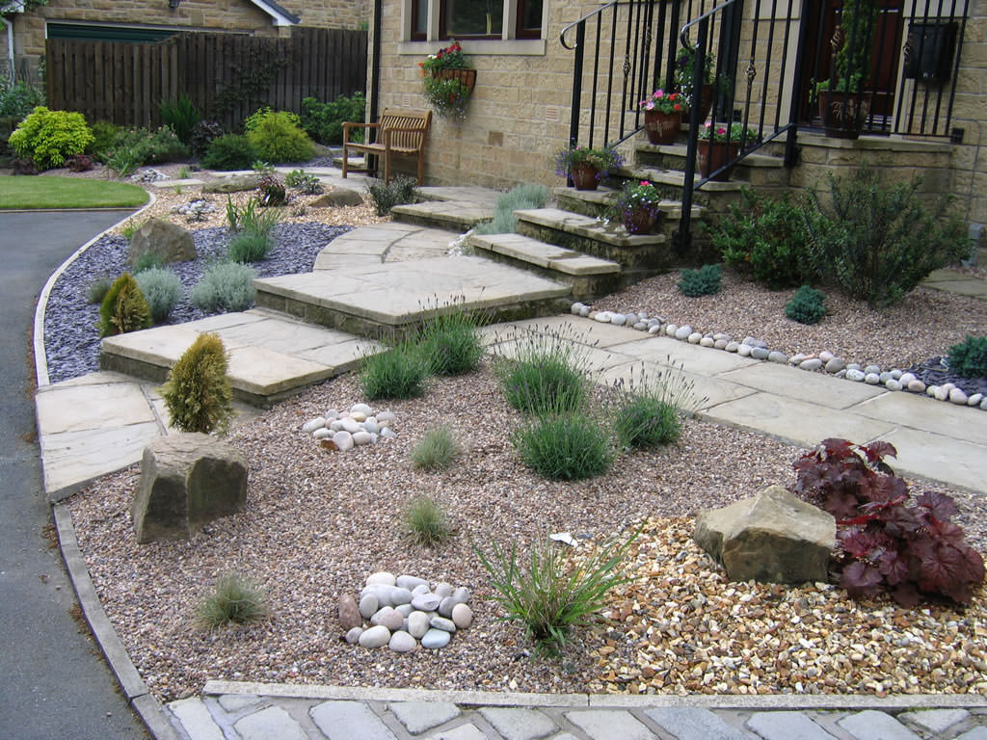
Access Control:
Natural:
  Environmental:
    Cactus
    Thorny bushes
    Rocks
    Dirt berms
    Ditches

Slide 49
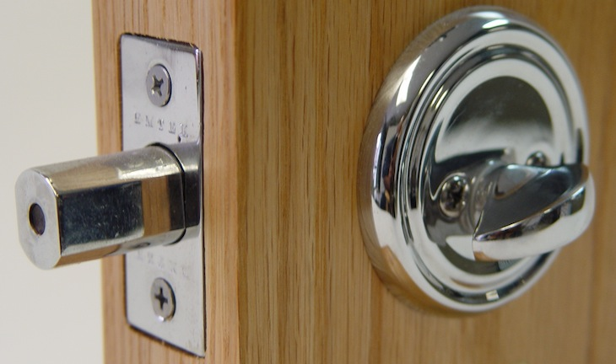
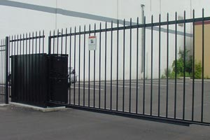
Access Control:
Mechnical:
  Devices
    Gates
    Deadbolts
    etc

Slide 50
Territoriality:
The “IMPRESSION” you get when you look at a property
Two Components:
Maintenance: Upkeep, clean, no litter
Defensible Space: Private space

Slide 51
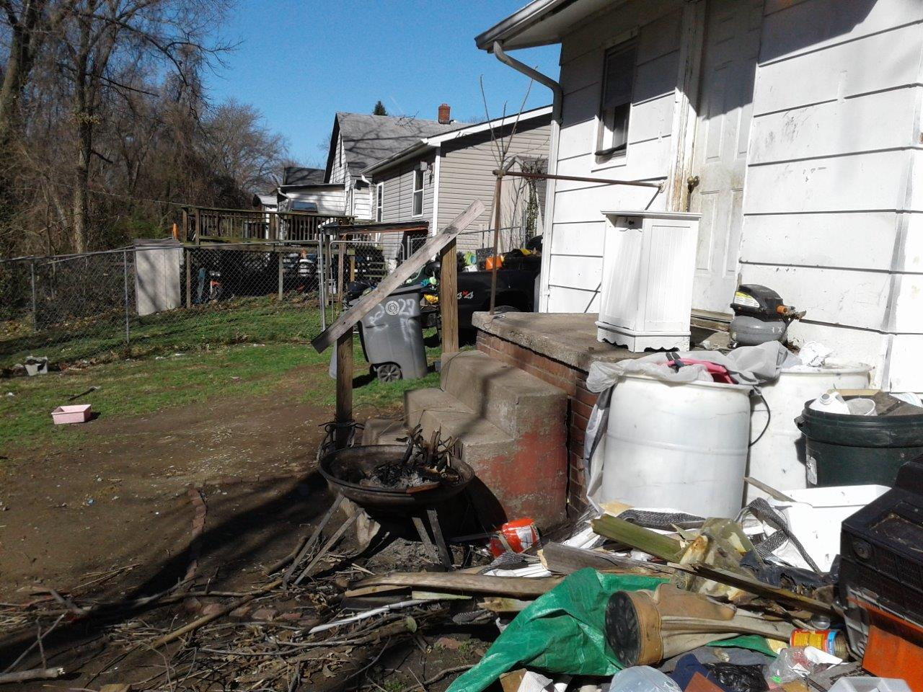

Slide 52
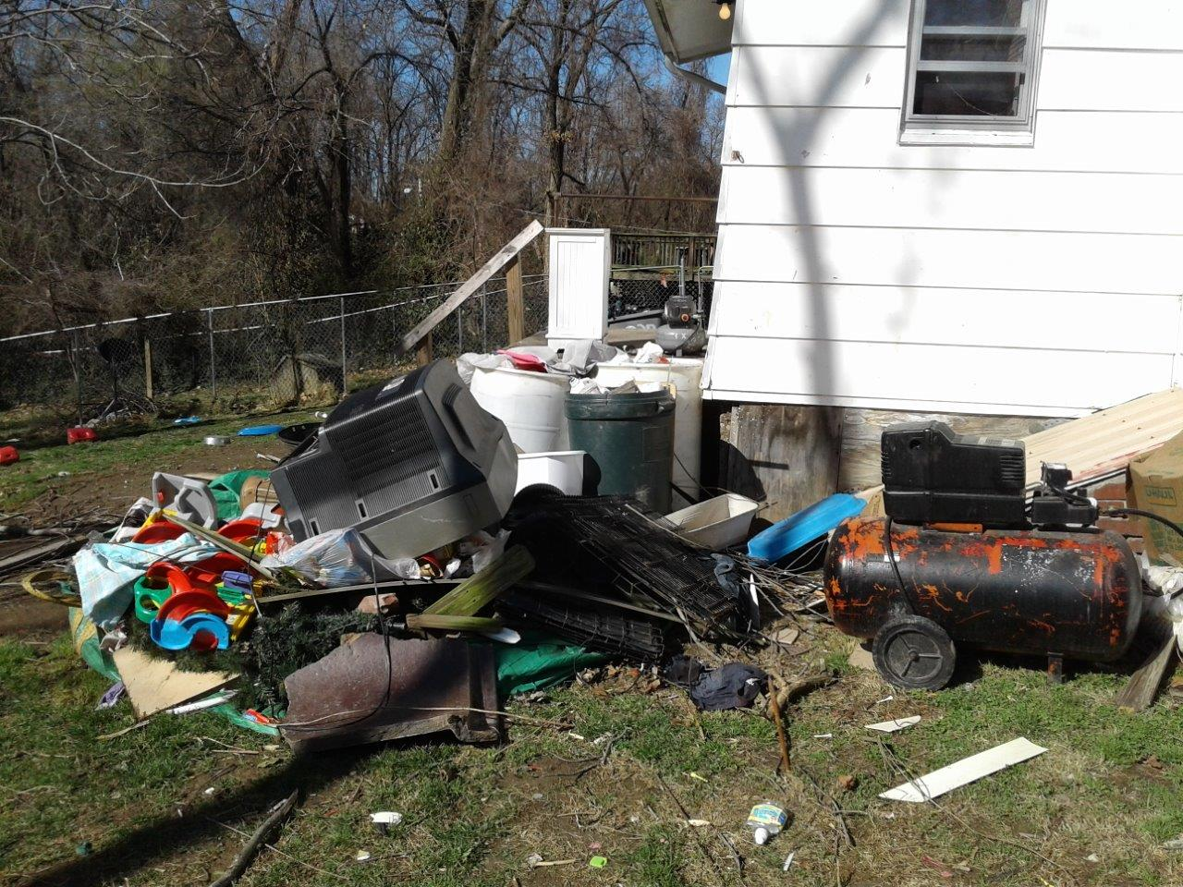

Slide 53
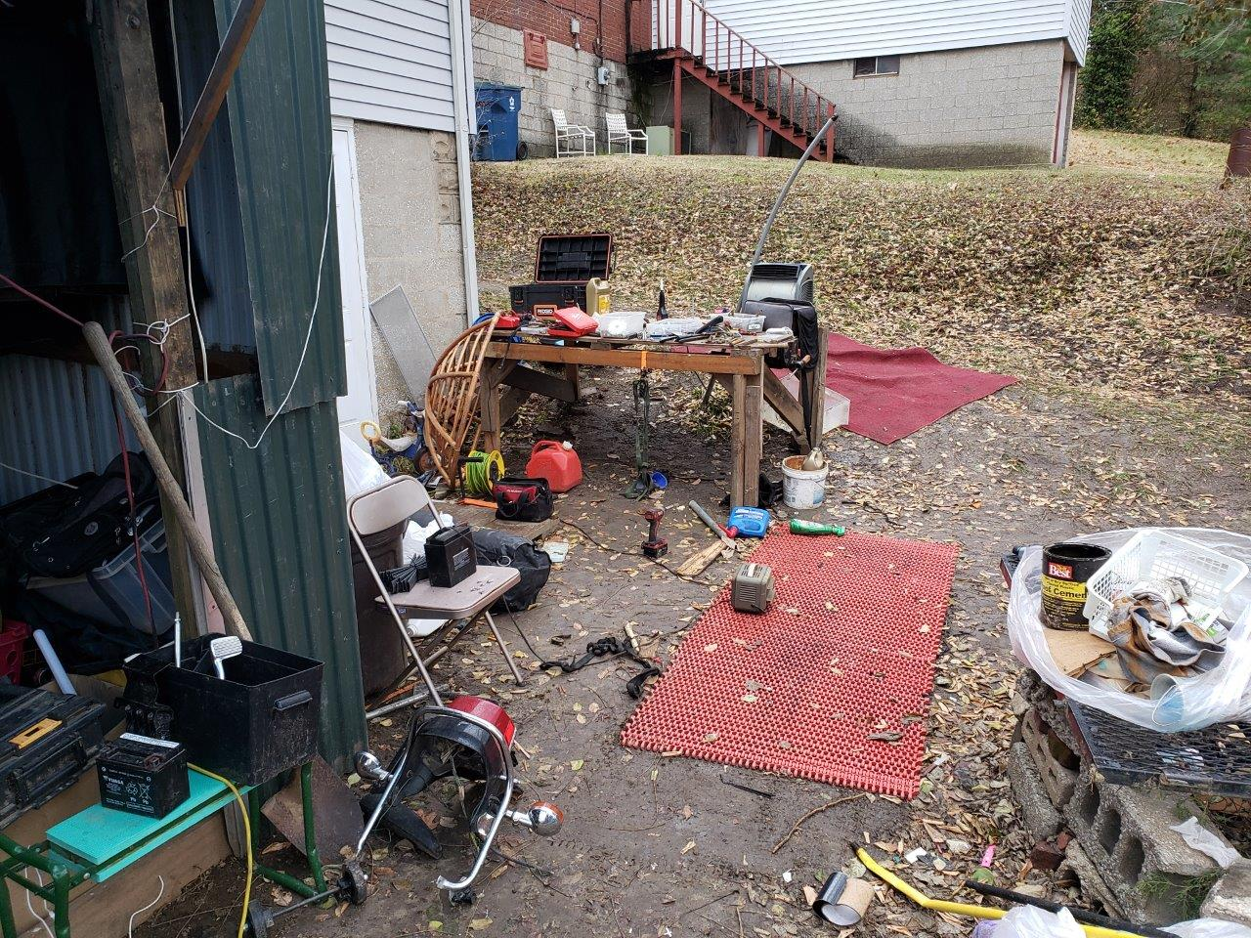

Slide 54
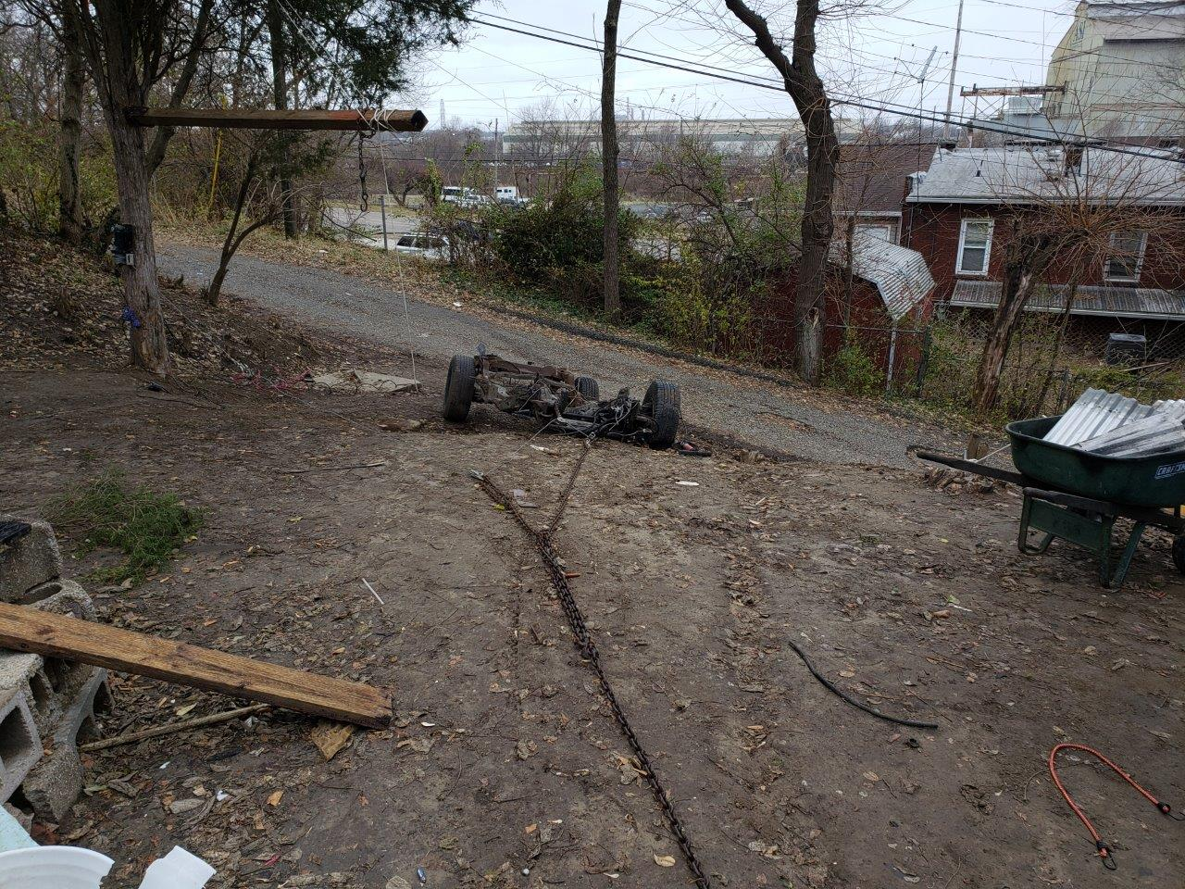

Slide 55
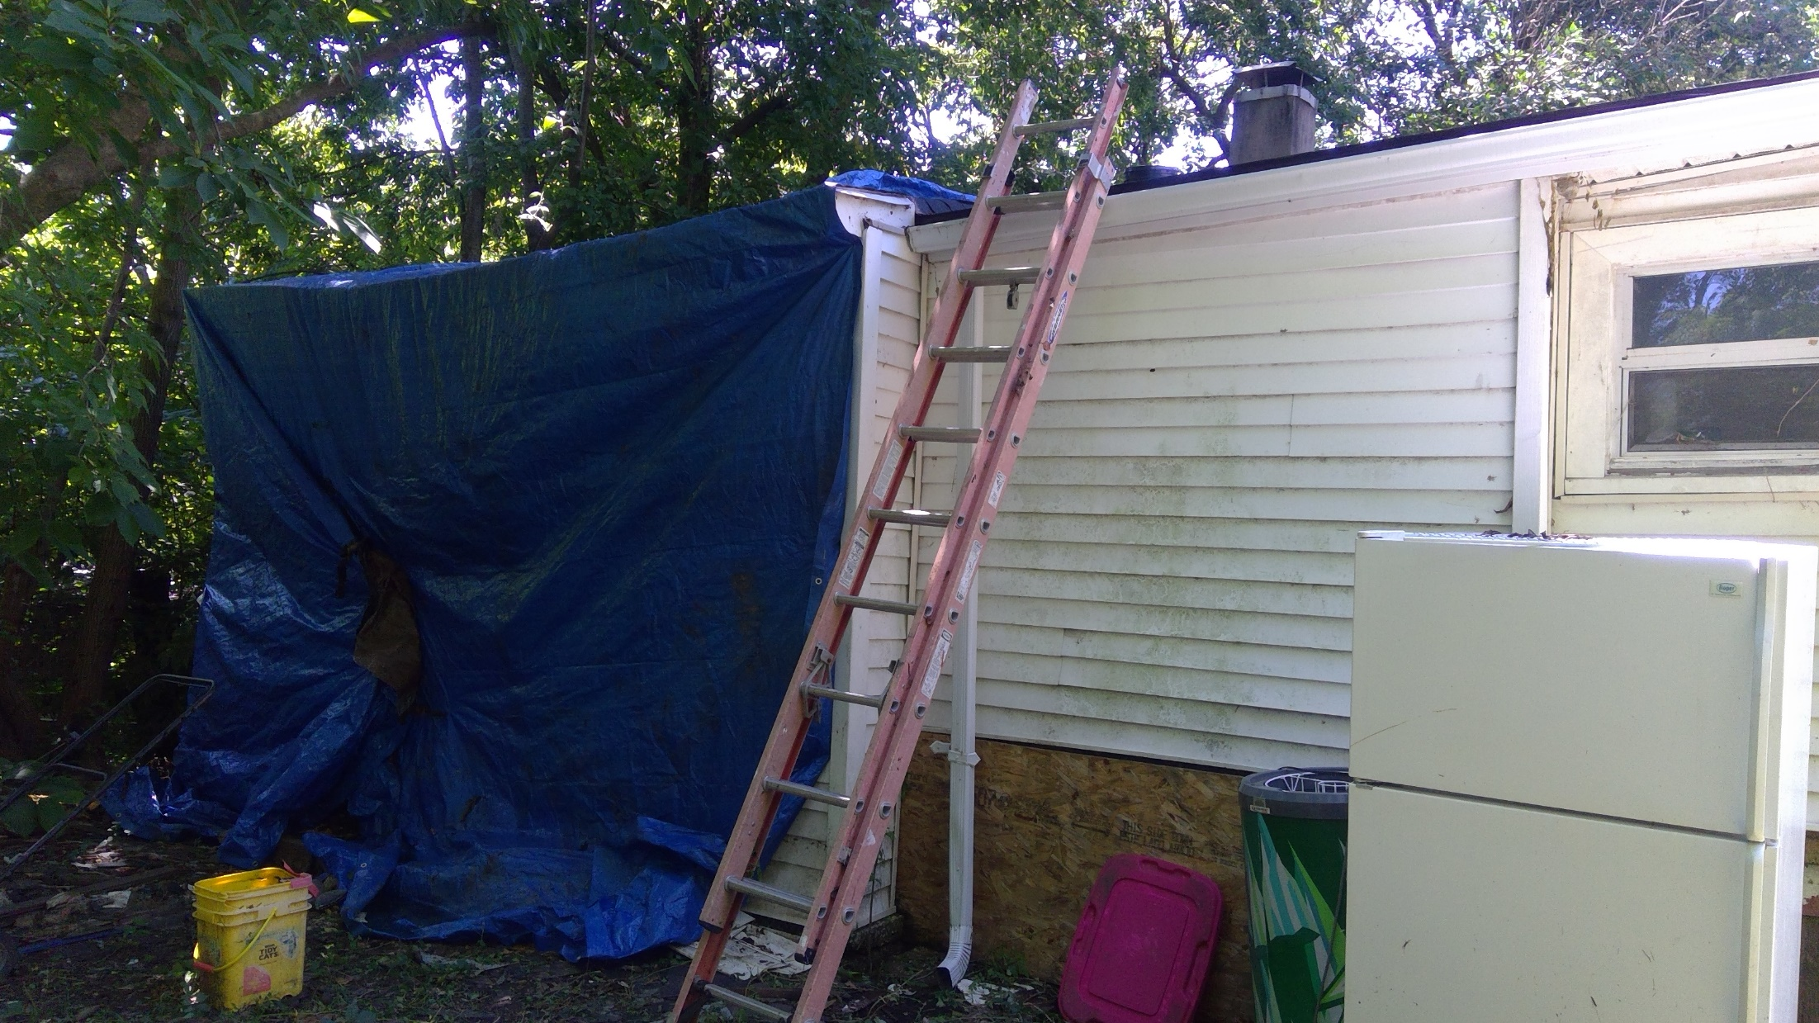

Slide 56
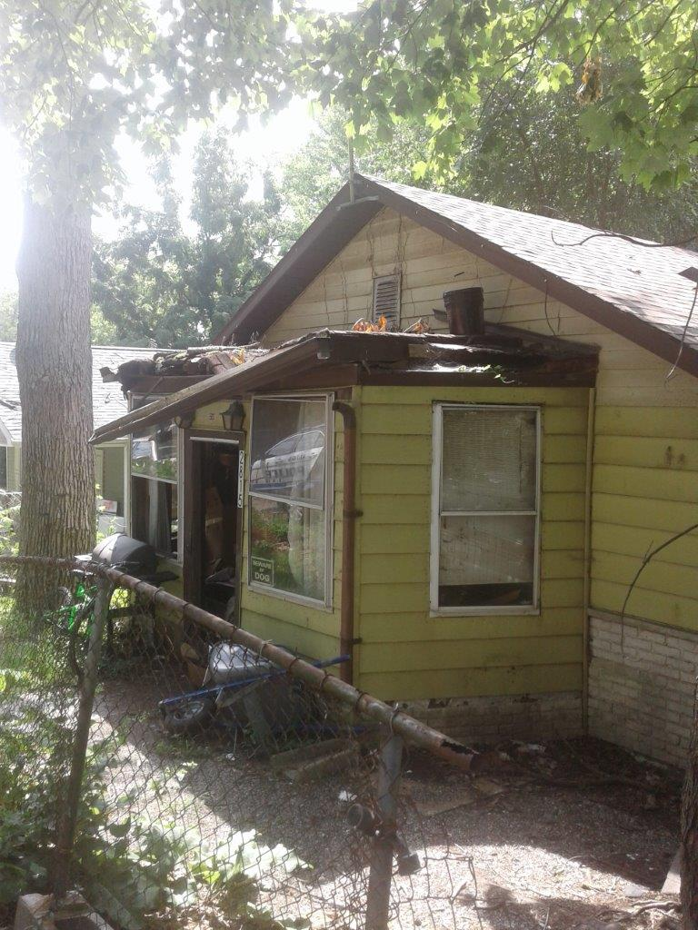

Slide 57
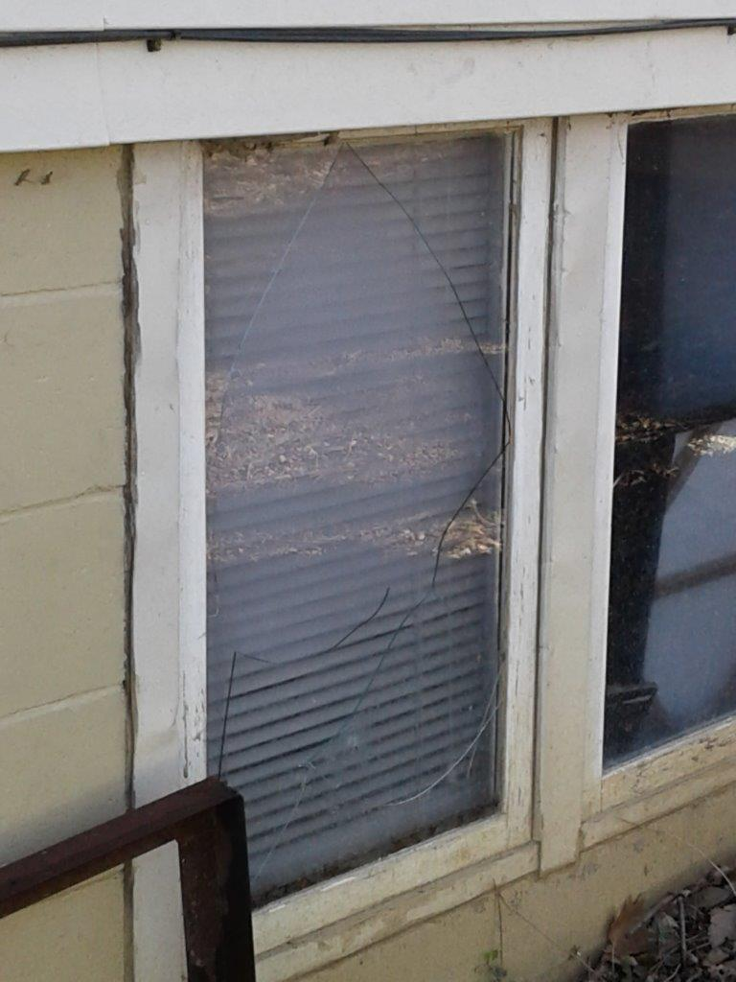

Slide 58
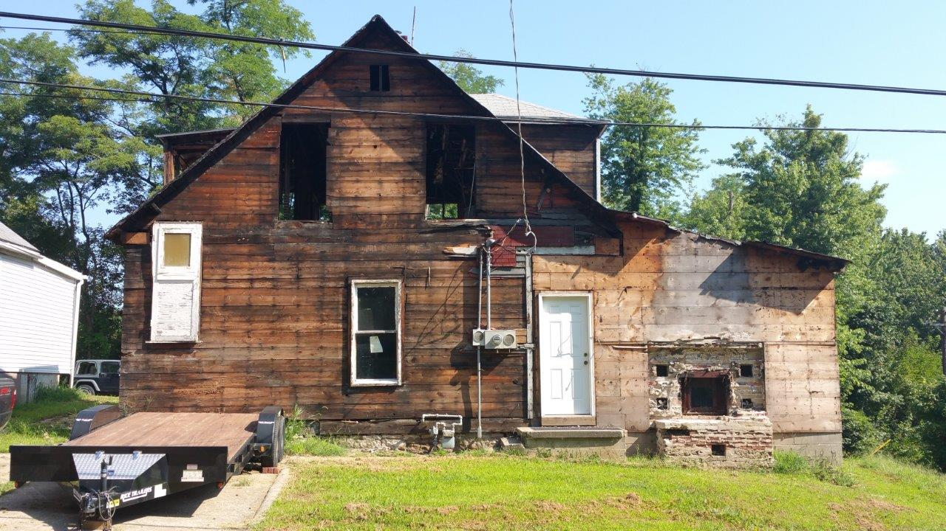

Slide 59
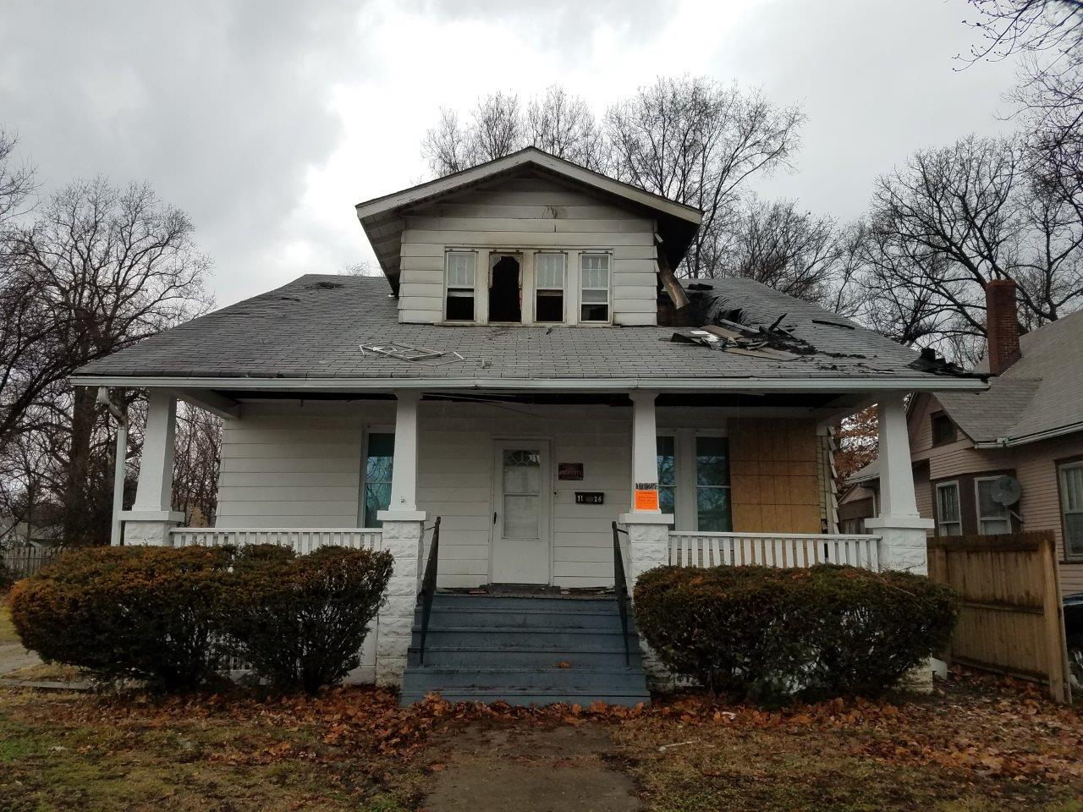

Slide 60
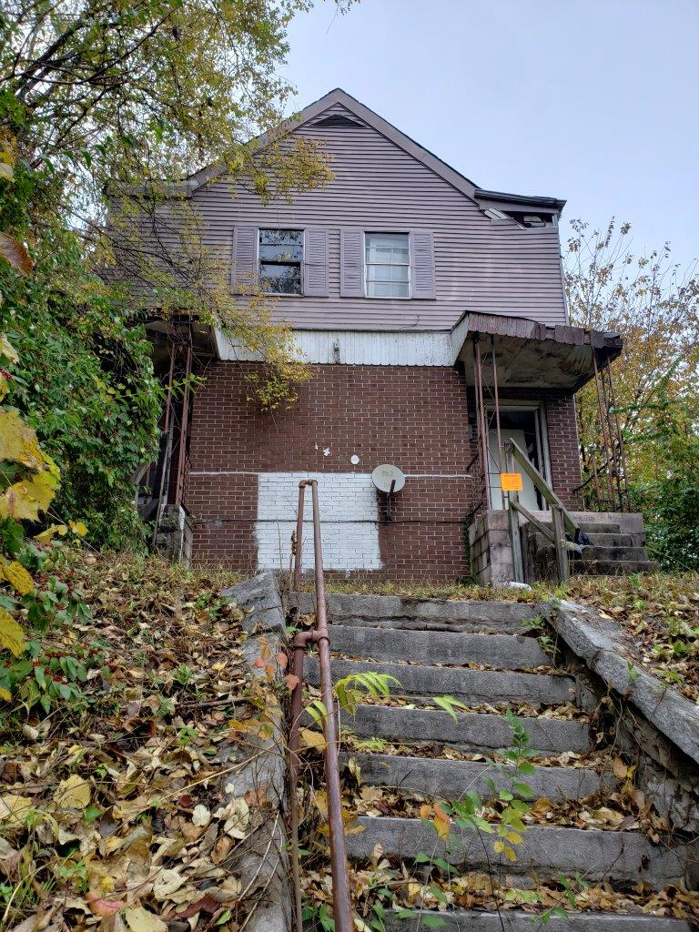

Slide 61
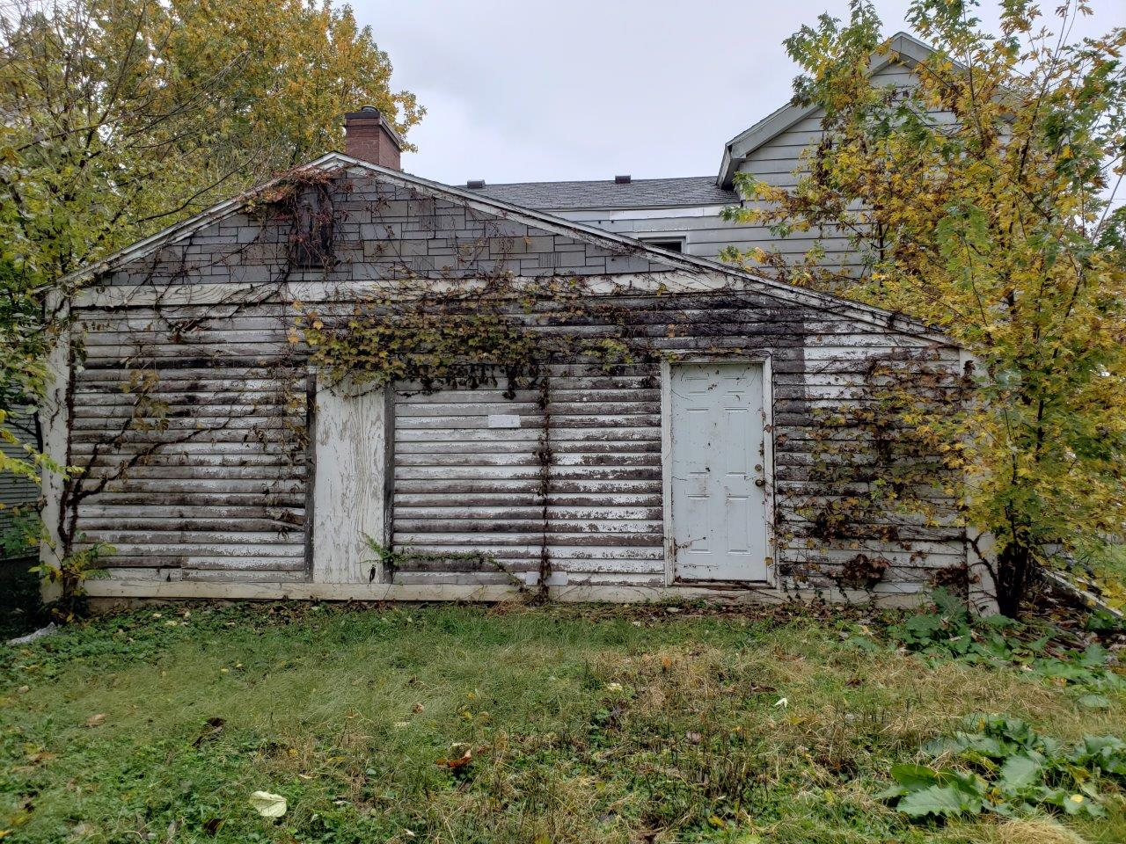

Slide 62
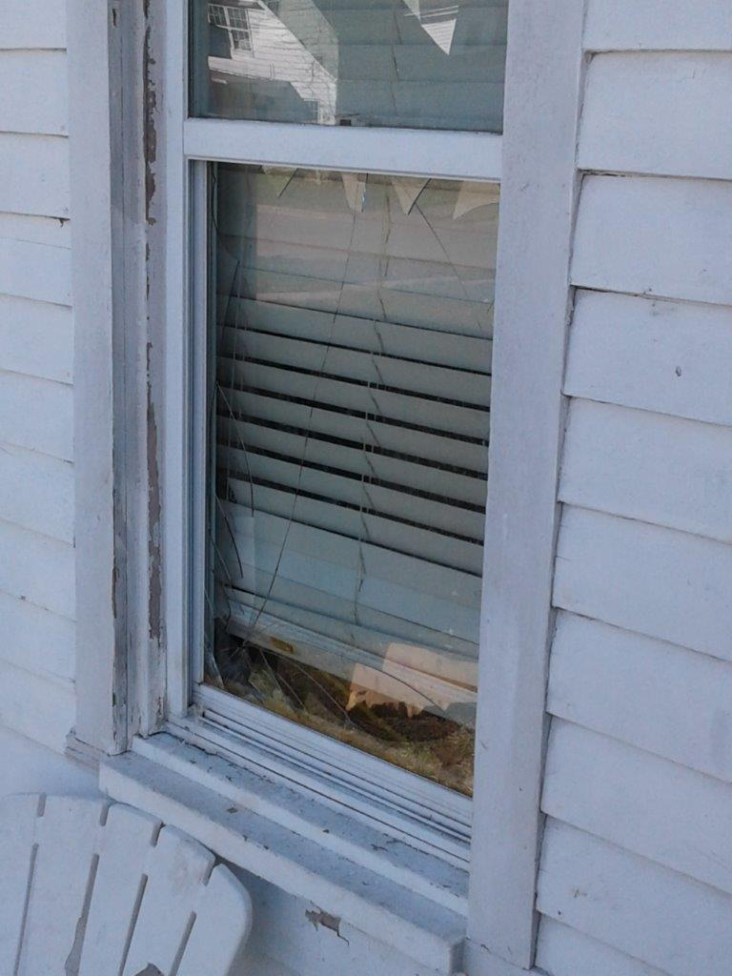

Slide 63
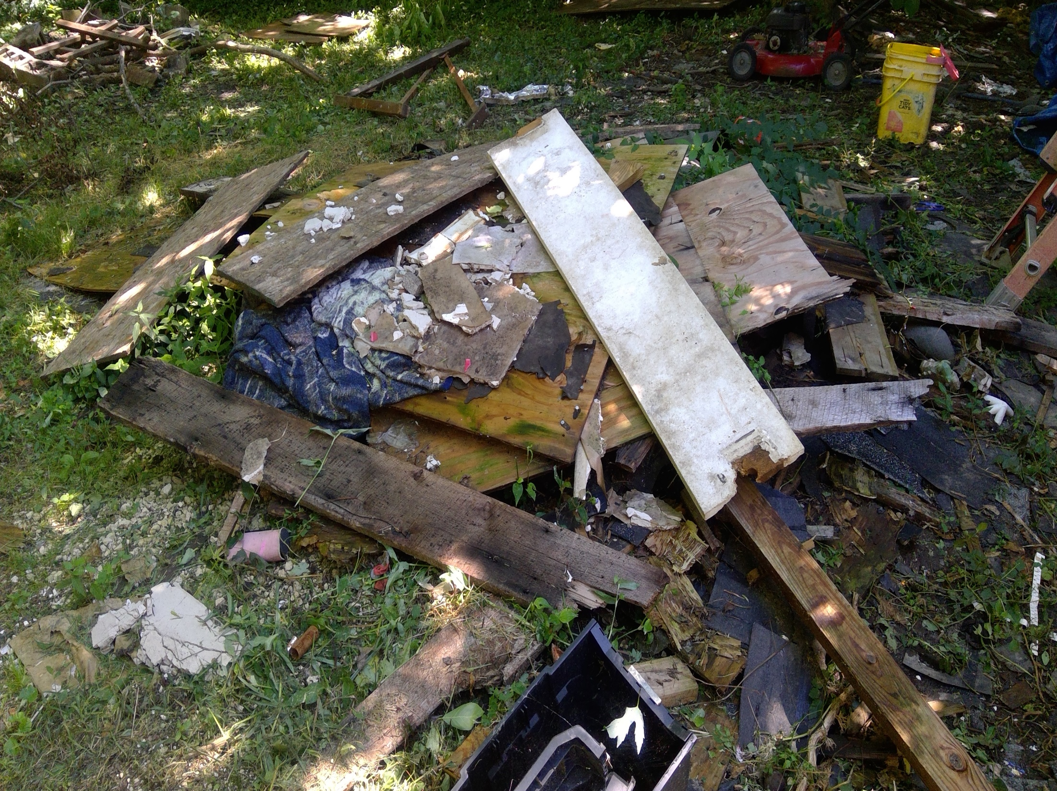

Slide 64
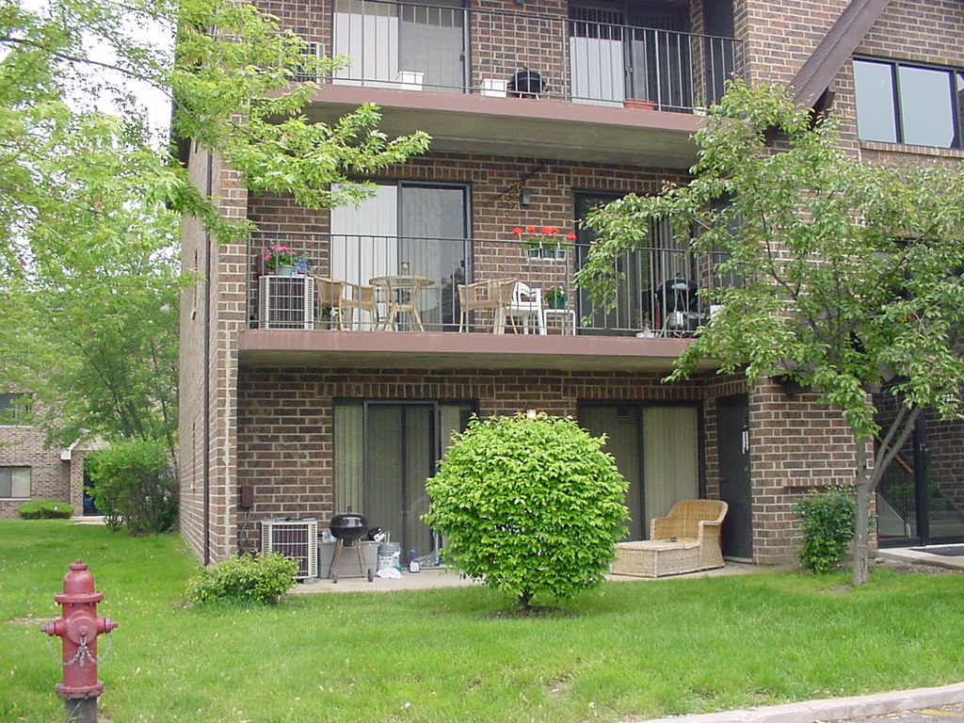
Defensible Space: Private?

Slide 65
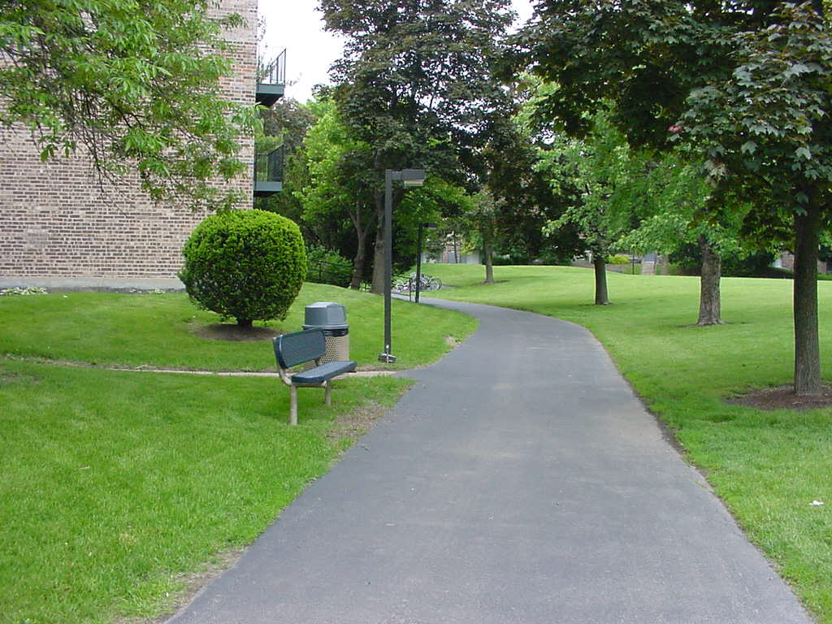
Activity Support

Slide 66
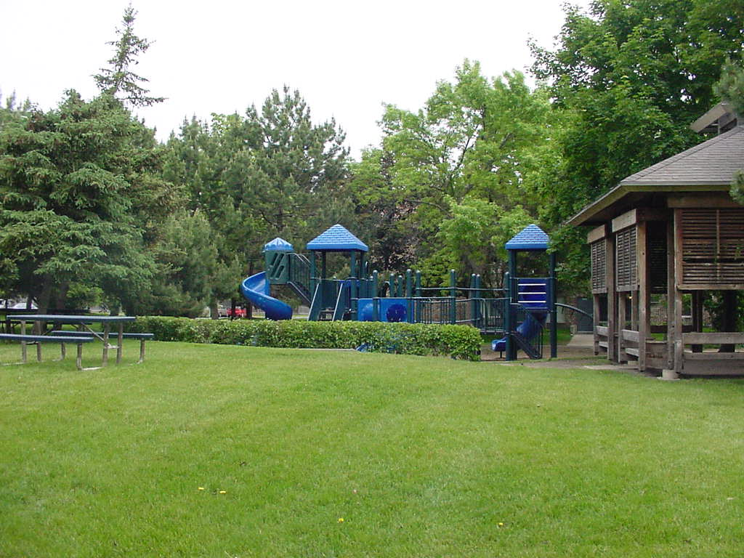

Slide 67
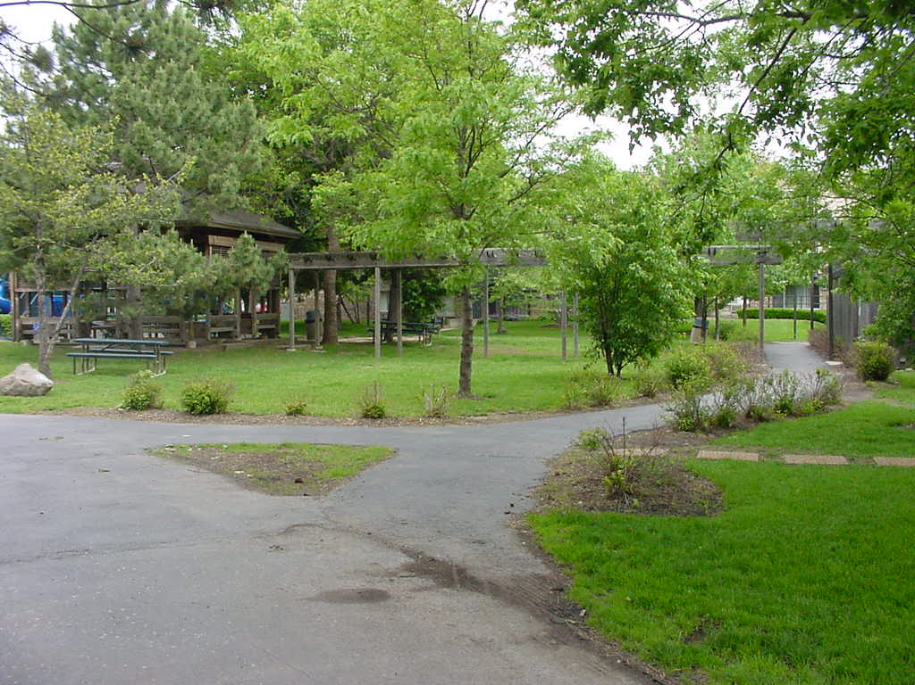

Slide 68
Criminals Ask Themselves…
How easy will it be to enter the area?
How visible, attractive, or vulnerable do the targets appear?
What are the chances of being seen?
If seen, what will anyone do about it?
  Sign complaints? Press charges? APATHY?
Is there a quick escape route?

Slide 69

Policing and the Air Displacement Theory
Police respond to a crime problem
We apply ‘pressure’ to the criminals
They simply move to another location
When we receive calls to another area, we have to move on
The criminals come back!
WHACK-A-MOLE!

Slide 70

ALTON CRIME FREE MULTI-HOUSING PROGRAM
Part Three: Application Process

Slide 71

Federal Fair Housing Laws:
Which people are in a protected class?
How many protected classes are there?
What are the protected classes?
Is there a penalty for discrimination against a member of a protected class?

Slide 72
FEDERAL FAIR HOUSING LAWS PROTECT:
Race
Color
Religion
Gender (Gender Identity)
Handicap
Familial Status
National Origin
Source of Income (Section 8)
Sexual Preference/Orientation
**BEHAVIOR IS NOT PROTECTED**

Slide 73
Recent Concerns
Section 8 Housing – Source of Income
Concealed Carry
Eviction
Medical Animals (PTSD, Autism, etc)
Medical Marijuana
Domestic Violence
  IDVA
  Safe Homes Act

Slide 74

Medical Marijuana
State Law vs Federal Law
Federal Fair Housing Laws
  Can you deny a potential renter who holds a medical marijuana card?
  Must you allow the use of medical marijuana on the property? In the unit?

Slide 75

Have a Statement of Rental Policy
Have WRITTEN and clearly POSTED policies
Apply them EQUALLY to ALL prospective residents
  FFH laws apply here
Consider an application ‘interview’:
  Startles the applicant
  Empowers the landlord
Ask: Have you ever been arrested for anything?

Slide 76

I D H R
I D H R
Presentation for Landlord/Property Manager EXPO
Mount Prospect Village Hall
March 23, 2013
Marian Honel

Slide 77
DISCLAIMER:
This presentation is intended for educational and informational purposes only. Nothing contained in this presentation should be considered as the rendering of legal advice either generally or in connection with any specific issue or case.
You should always consult with an attorney for legal advice as to any specific issue or case.

Slide 78

What is Fair Housing?
The right for all people to live wherever they choose, to have access to housing (seek, purchase, sell, lease or rent) and enjoy the full use of their homes without unlawful discrimination, interference, coercion, threats, or intimidation by owners, landlords or real estate agents or any other persons.

Slide 79
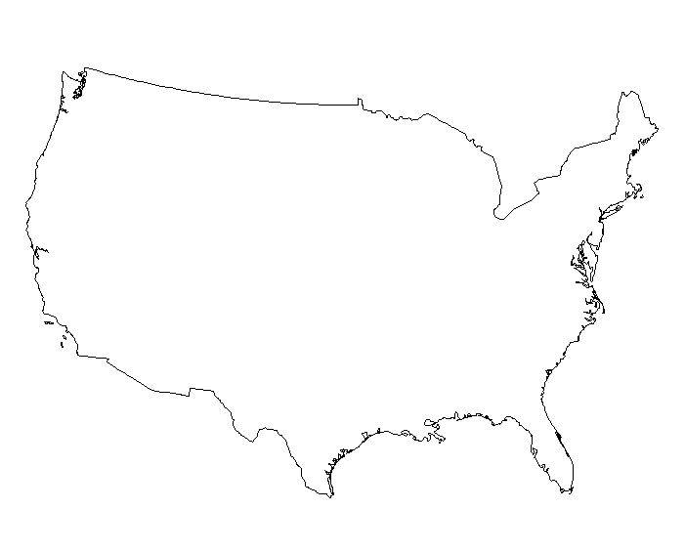

Federal Fair Housing Law
7 Protected Classes:
Race
Color
Religion
National Origin
Sex (incl. sexual harassment)
Disability (mental and physical)
Familial Status

Slide 80
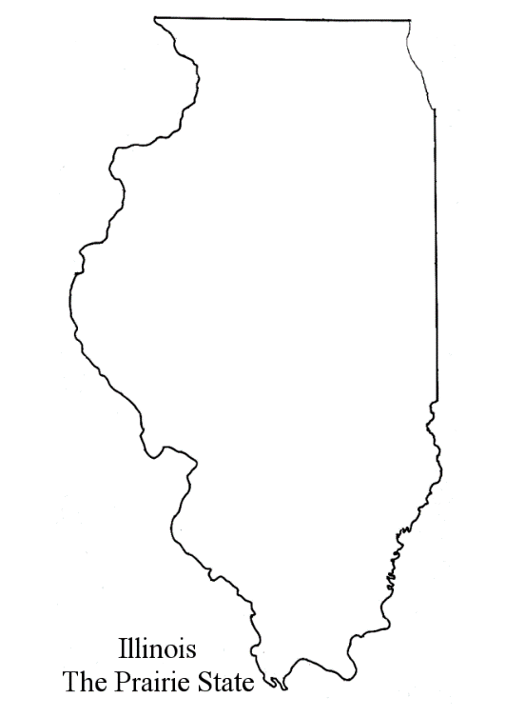

State Fair Housing Law
7 Additional Protected Classes in Illinois:
Ancestry
Age (40 and over)
Marital status
Military status
Unfavorable discharge from military service
Sexual orientation (incl. gender identity)
Order of Protection Status

Slide 81
Familial Status
Families with children under age 18
Women who are pregnant
Persons in the process of adopting children or obtaining legal custody of minors

Slide 82

Disability
An impairment that substantially limits a major life activity (federal definition)
Determinable physical or mental characteristic which may result from disease, injury, congenital condition of birth or functional disorder which is unrelated to the person’s ability to acquire, rent or maintain a housing accommodation (Illinois Human Rights Act)

Slide 83

Sexual Orientation
Sexual Orientation - actual or perceived heterosexuality, homosexuality, bisexuality, or gender-related identity, whether or not traditionally associated with the person's designated sex at birth

Slide 84
Order of Protection Status
“A person's status as being a person protected under an order of protection issued pursuant to the Illinois Domestic Violence Act of 1986 or an order of protection issued by a court of another state.”
Cannot be used as the basis for denying a rental application, evicting, etc.

Slide 85
Also Covered:
Association – refers to persons associated with the tenant, such as children or friends
Retaliation – differential treatment because a person complained of or reported discrimination
Intimidation – harassment/other actions because of a protected class, related to enjoyment of a housing accommodation (neighbor to neighbor)
Coercion – attempts to force someone to discriminate

Slide 86


Other Fair Housing Laws
Cook County housing ordinance also covers
    Housing status (e.g., homeless)
    Source of income (excl. housing choice vouchers)
Local ordinances may cover additional bases (e.g. City of Chicago includes housing choice vouchers)

Slide 87

Facts
Nationwide, 10,000+ charges filed yearly
Most common allegation: discrimination in the terms and conditions of the sale or rental
An estimated 3.7 million incidents occur annually
Housing discrimination is perpetuated by other elements such as segregation, predatory lending, and gentrification

Slide 88
Reported Housing Discrimination in Illinois
IDHR Housing Division FY2012:
Inquiries…………………….…1046
Charges Filed……………..….. 313
Completed Investigations….. 366
Bases of Discrimination:
Physical/Mental Disability ….…... 42%
Race……………………….…....…. 37%
Familial Status………………........ 14%
National Origin/Ancestry..……....... 13%
Sex……………………..…………… 10%
Retaliation…………………….…….. 6%
Sexual Orientation/Gender Identity… 4%
Note: many charges were filed under more than one basis

Slide 89
How to Protect Yourself
Learn about fair housing laws
Make sure your staff and agents follow the law
Challenge your stereotypes (attend diversity training)
Have policies and practices and follow them consistently

Slide 90
Who is Bound by the Fair Housing Laws?
Any person engaging in real estate transactions:
Landlords
Property owners
Property management companies
Condominium or housing associations
Real estate brokers, salespersons and appraisers
Agents of all the above
And…

Slide 91

And…
Lending institutions and their agents
Building developers and architects and their agents
Insurance companies
Newspapers
Municipalities

Slide 92
What is Covered?
Both commercial and residential transactions are covered:
  State law covers all real property for sale, exchange, rental or lease
  For purposes of appraisals and loans, only residential property is covered.

Slide 93
What Do Fair Housing Laws Prohibit?
Discrimination in the sale or rental of real estate
    Racial steering
    Discouraging
    Exaggerating drawbacks
    Failing to mention positives
    Communicating incompatibility
    Segregating

Slide 94
What Else Do Fair Housing Laws Prohibit?
Discrimination in the terms, conditions or privileges of a real estate transaction
  Sexual harassment and harassment
  Insurance redlining
  Refusal to provide municipal services or property or hazard insurance for a dwelling
  Differential treatment (repairs, lease violation notices)

Slide 95
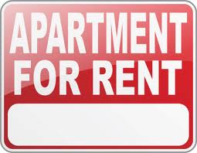
Discriminating in Advertising
Printing, circulating, posting, mailing, or publishing a written or oral statement, advertisement or sign indicating an intent to discriminate on a prohibited basis

Slide 96
Applies to Anyone Placing Ads:
Landlords, home sellers, housing providers, realtors, lenders
Ad agencies, publishers, newspapers, directories, multiple listing services

Slide 97
ADVERTISING: Is This Legal?
APARTMENT FOR RENT
2 Bedroom/2 Bath, $1500 per month
No more than 2 people preferred
Living room has a fireplace, master bedroom has walk-in closet, second bedroom makes for a great office. Hardwood floors. Located in a quiet 10 floor building. Walking distance to the train.

Slide 98
Tips for Advertisers – what message are you sending?
Describe the apartment and neighborhood in neutral language
Detail the application procedures
Give the address/nearest intersection
Use diverse models (race, family type, disability)
Describe the property, not your idea of who would want to live there.

Slide 99
Disability Issues
Housing providers must make reasonable accommodations or modifications for persons with disabilities

Slide 100
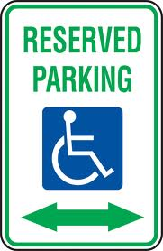
Examples of Reasonable Accommodations for Disabled Persons
  Change in parking rule
  Reserved accessible parking space
  Different way to get mail or pay rent
  Change in due date for rent
  And…

Slide 101

Accommodation in pet policies for a guide, hearing, or support dog – if needed by a person with a disability
Cannot refuse to rent or discriminate in terms, conditions or privileges
Cannot charge a pet deposit
May charge for actual damages
Cannot require certification or training for the animal

Slide 102

Reasonable Modifications for Disabled Persons
If necessary to afford such person full enjoyment of the premises
At the expense of the tenant
Landlord may require the tenant to pay into an escrow account

Slide 103

Examples of Reasonable Modifications for Disabled Persons
  Adding support bars to bathroom
  Removing doors
  Changing sink to accommodate a wheelchair
  Adding an exterior ramp

Slide 104
Exemptions from Fair Housing Laws
Owner-Occupied Exemptions:
Apartments in buildings with 4 units or less if the owner lives in one of the units (“Mrs. Murphy” exemption)
Room rental in a private home if the owner resides in the building
BUT NOTE: Some local ordinances cover all dwellings (e.g. Cook County, City of Chicago)
No exemption re: race discrimination

Slide 105
Other Exemptions (limited):
Non-profit religious organizations may give housing preference based on religion
Certain types of affordable housing units may segregate by disability
“Senior housing” may discriminate against families with children (not applicable to HUD-insured or HUD-subsidized buildings, or to Housing Authorities if household is otherwise qualified (age, income, unit size)

Slide 106
Requirements for Accessible New Construction
Applies to most multi-family buildings of 4 or more units; if no elevator, then just the ground floor is covered
Includes requirements such as accessible entrance, 36” route within the dwelling, accessible common use areas, higher wall plugs, lower light switches, and usable kitchens and bathrooms

Slide 107
Investigating Charges
Intake
Service of charge
Investigation
  Interview complainant and respondent
  Obtain documents
  On-site
  Interview other witnesses

Slide 108

Evidence of Discrimination
Signs or ads
Statements
Disparate treatment
Testing evidence
Documents
Witness testimony

Slide 109
Defenses
Legitimate non-discriminatory reason
Favorable treatment of others in the protected class
Reasonable local, state, or federal occupancy standards
Exempt

Slide 110

Tips for Respondents
Tell the truth
Keep good records—document actions
Have stated policies and practices and follow them
Document reasons for deviations from policies

Slide 111

Remedies and Damages
Civil penalties
Injunctive and equitable relief
Monetary damages for actual damages suffered, such as higher rent costs, emotional damages
Attorneys fees and costs
Federal court and some local ordinances allow for punitive damages (e.g. Cook County, City of Chicago)

Slide 112
Scenario 1
An apartment seeker who uses a wheelchair has found a second-floor apartment in an older walk-up building. He asks the landlord to put in an elevator so he can reach the unit, but the landlord refuses.

Slide 113
Scenario 2
A rental complex advertises a spacious one-bedroom apartment. When a couple with a newborn applies, the property manager turns down their rental request, saying that a one bedroom is not sufficient for three people.

Slide 114
Scenario 3
A woman applies for an apartment. She has good credit and the required deposit. When the property manager calls the prospective tenant’s previous landlord, she finds out that the woman and her ex-partner used to throw loud, late-night parties that caused some of the other tenants to complain. The property manager turns down her rental application.

Slide 115
Scenario 4
A woman with a ten-year-old son and a high credit score, excellent landlord references and adequate income from child support and Social Security disability benefits is denied housing in favor of an elderly, retired couple with lower credit scores, lower income and no references.

Slide 116
Marian Honel
Manager, Fair Housing Division
Illinois Department of Human Rights
100 West Randolph St., Suite 10-100
Chicago, IL 60601
Marian.Honel@illinois.gov
IDHR.FairHousing@illinois.gov
312.814.6219

Slide 117
The Rental Application:
Should Ask About Criminal History
Felonies AND also Misdemeanors!
Plea Bargains
Probation/Parole
About Current Criminal Activity
Illegal Drug Use

Slide 118
How to Verify Information:
Don’t Take Shortcuts
Compare ID to Information Given
Identify PREVIOUS Landlords
Have a STANDARD List of Questions
Get Co-Signers
Verify Income Sources
Run a Credit/Criminal Check
**Plan your words very carefully, most discrimination lawsuits are filed when an owner/manager has said too much!**

Slide 119
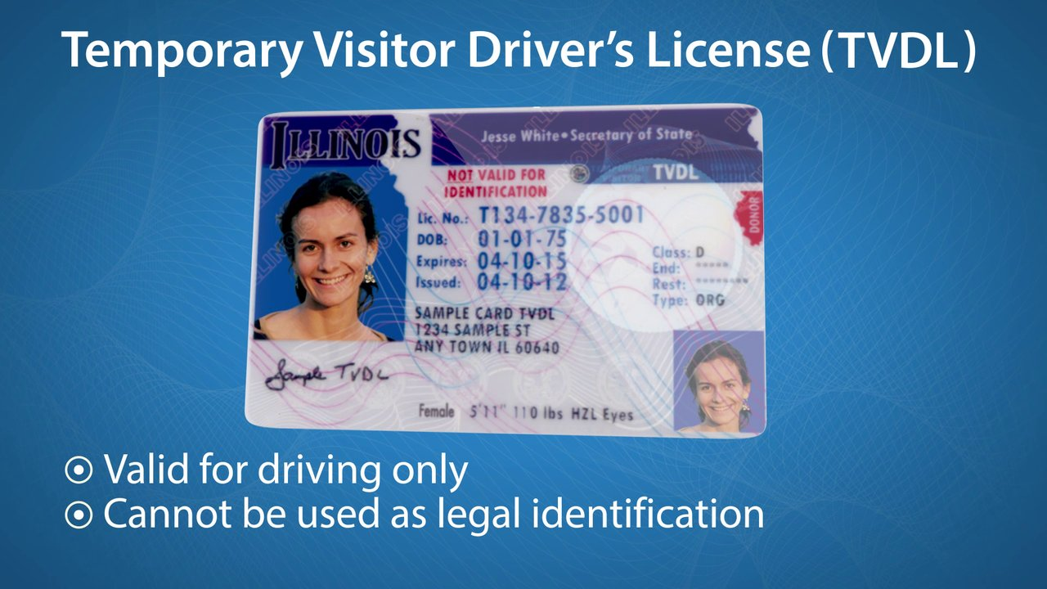

Slide 120
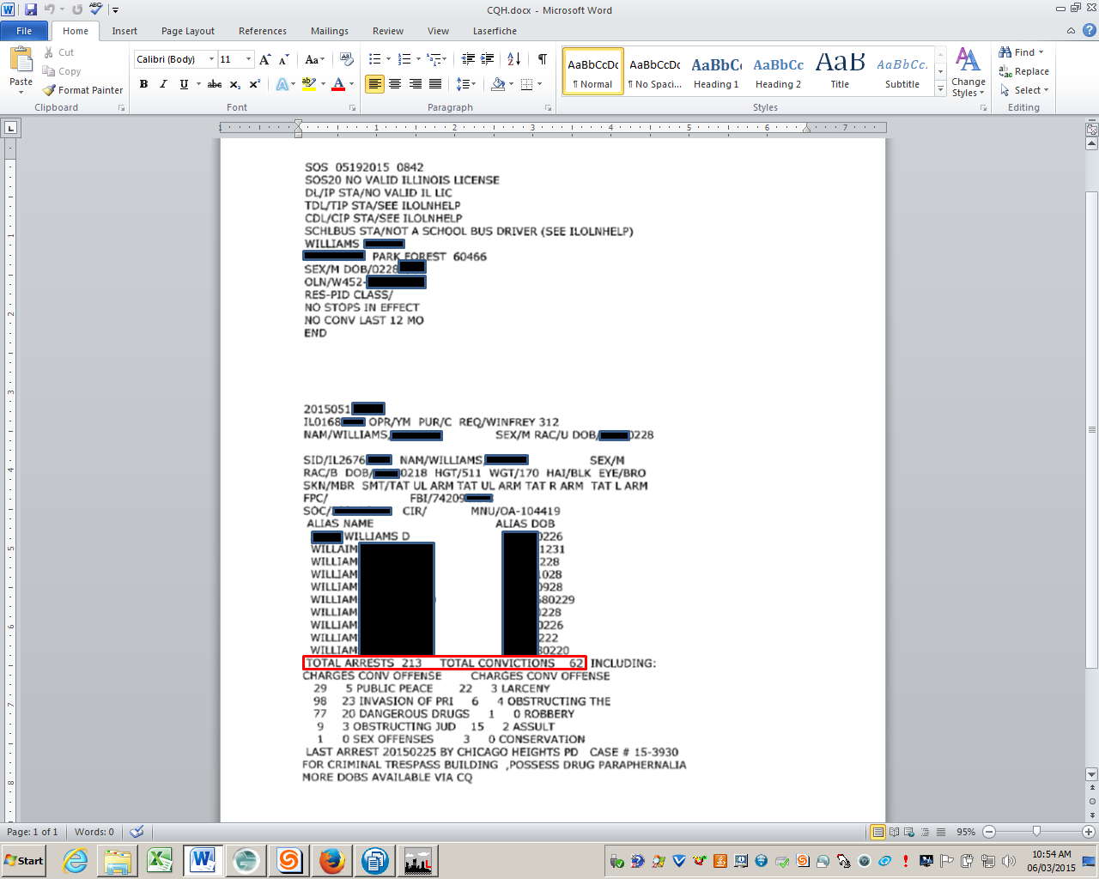

Slide 121
Why Inspect?
Something Else to Keep in Mind
Crime is not the only issue on some properties
Unsanitary conditions
Neglected children
Mental disabilities
Senior citizens

Slide 122
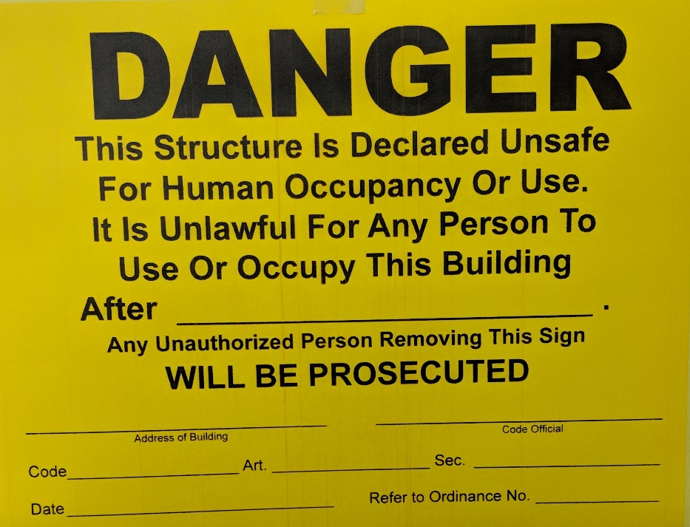
UNFIT FOR OCCUPANCY
Such defects or conditions found create a hazard to the health, safety or welfare of the occupants or of the public

Slide 123
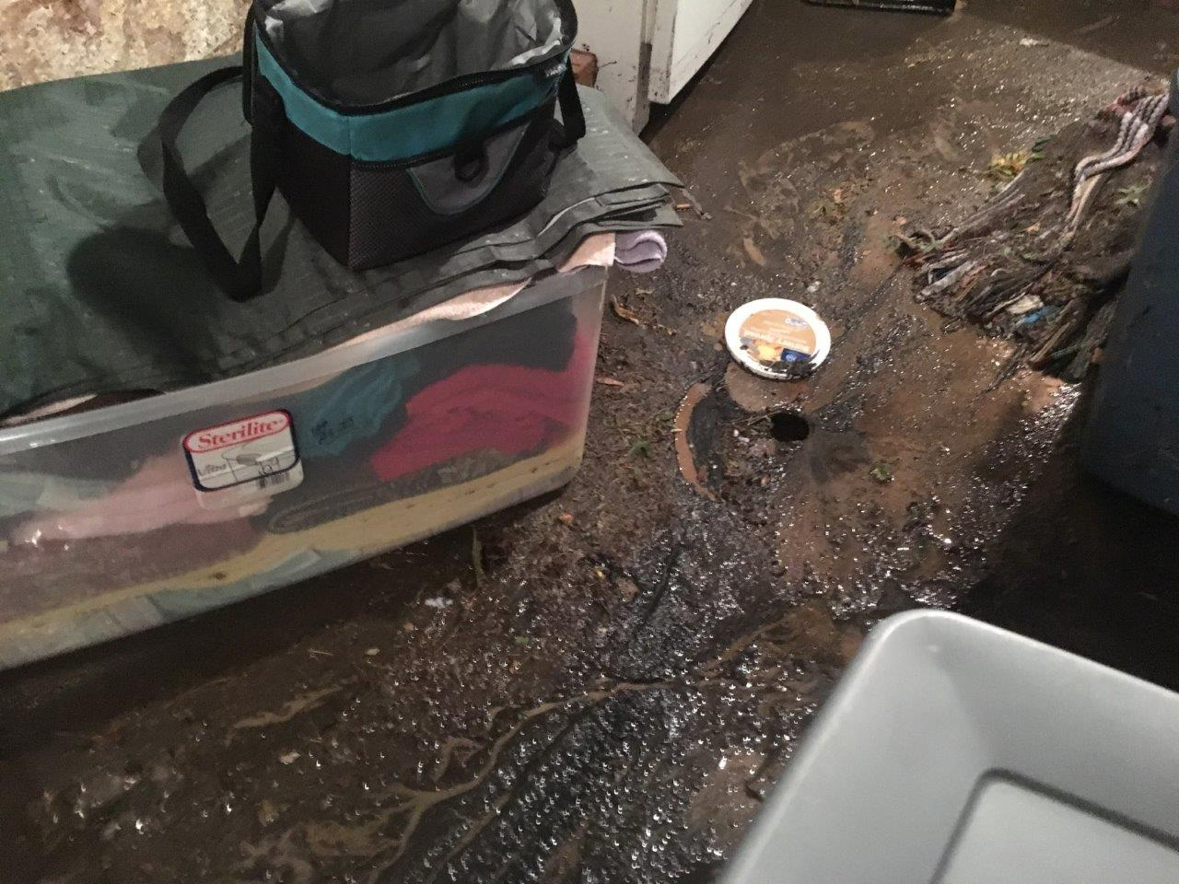

Slide 124
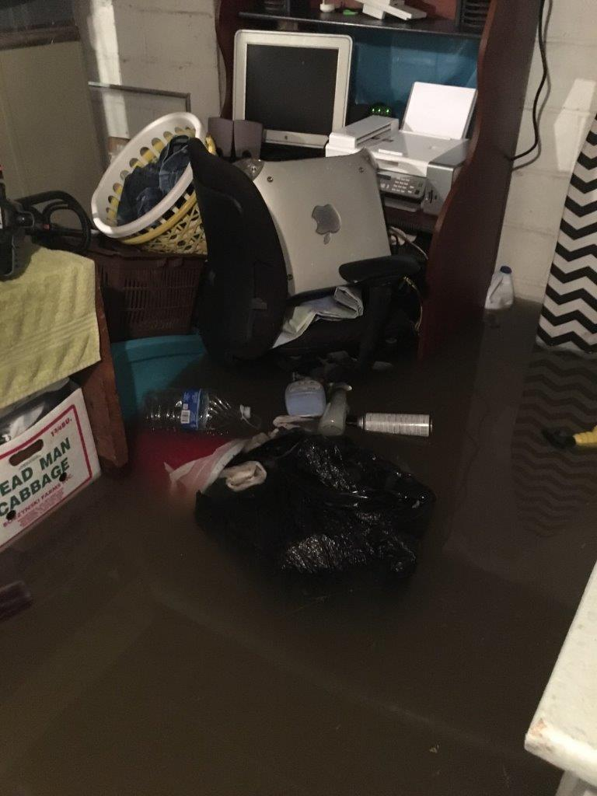

Slide 125
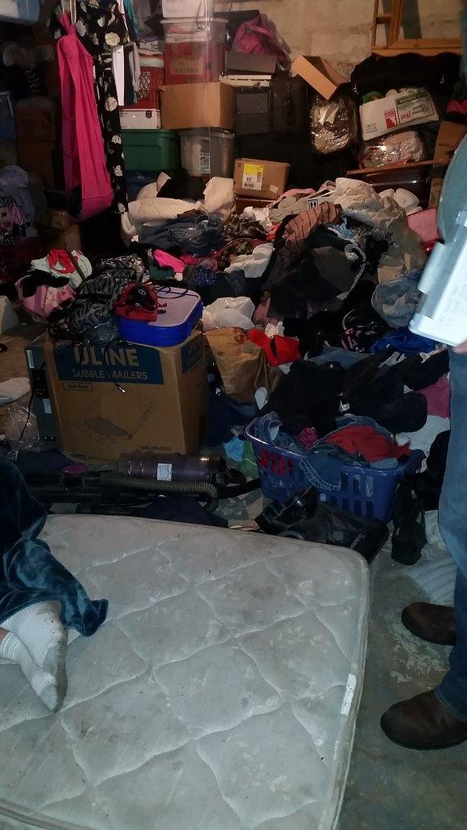
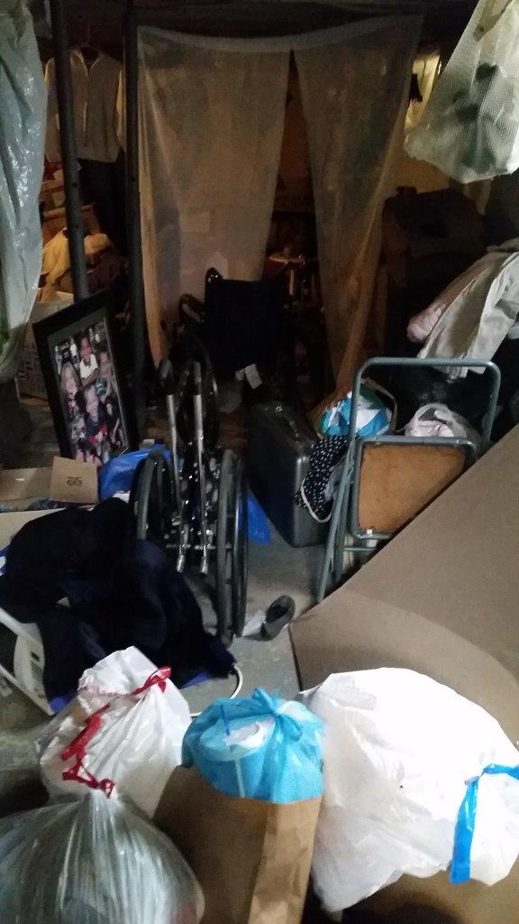

Slide 126
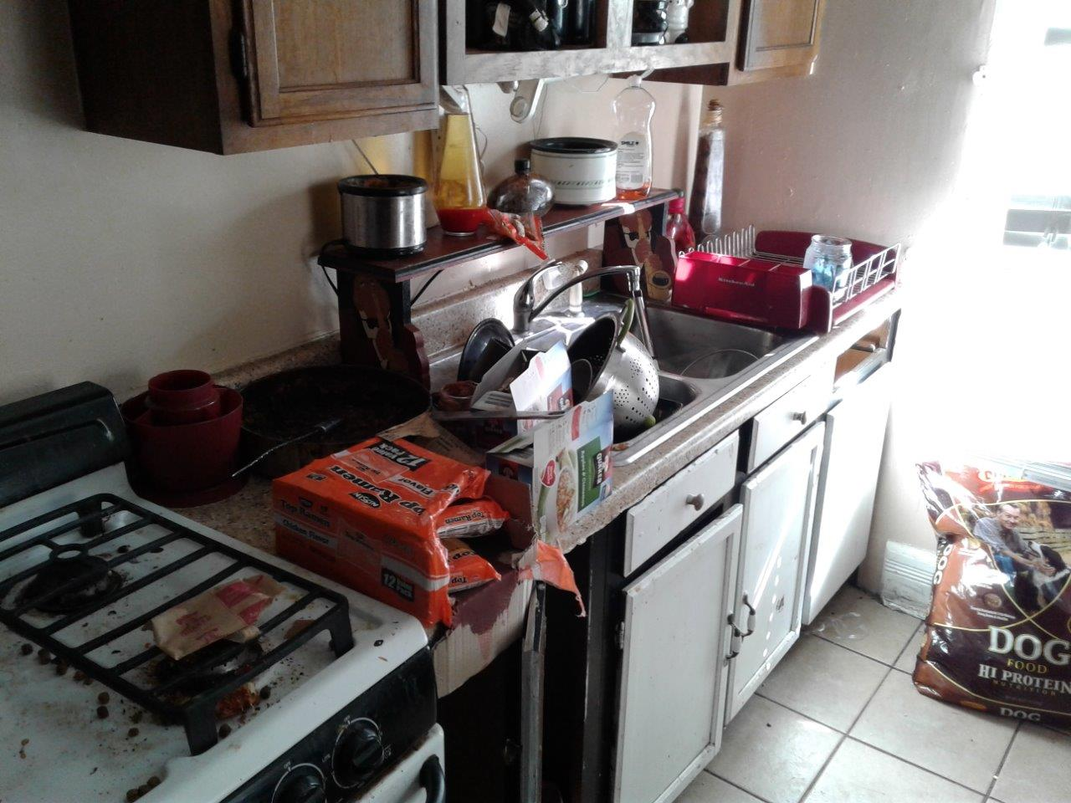

Slide 127
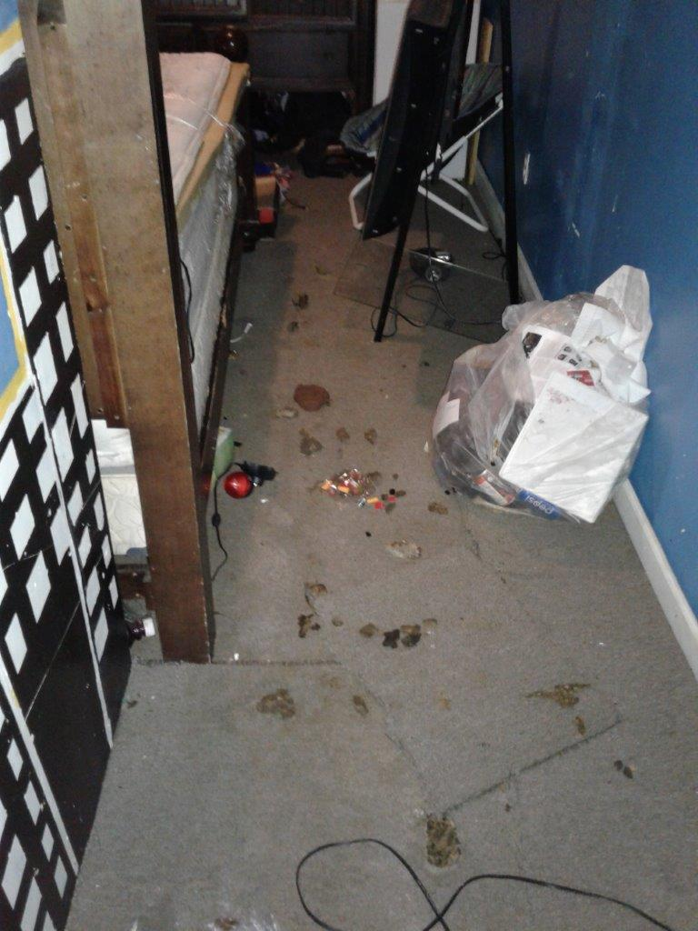
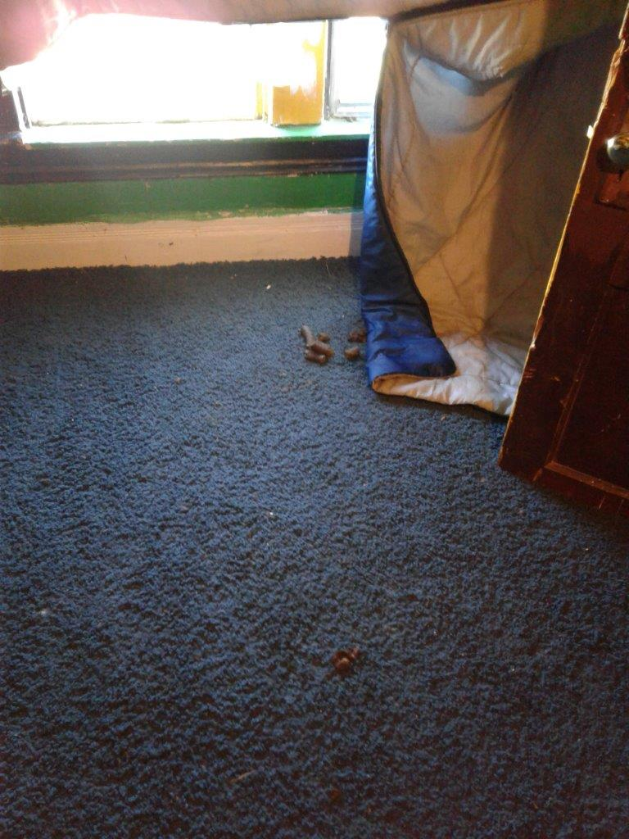

Slide 128


Slide 129


Slide 130


Slide 131


Slide 132


Slide 133


Slide 134


Slide 135


Slide 136


Slide 137


Slide 138


Slide 139


Slide 140


Slide 141


Slide 142


Slide 143


Slide 144


Slide 145


Slide 146


Slide 147


Slide 148


Slide 149


Slide 150


Slide 151


Slide 152


Slide 153


Slide 154


Slide 155


Slide 156


Slide 157


Slide 158


Smoke/Carbon Monoxide and Door Closers
Landlords are responsible for life safety devices, however, they may depend on tenants to maintain them
Change batteries and test at daylight savings

Slide 159


INTERIOR INSPECTIONS – PEST CONTROL

Slide 160


Slide 161

Other Common Rental Issues
Overcrowding
  70 sqft of bedroom space for the first occupant
  50 sqft for each additional occupant
Excessive animal housing
  6 animals per household – 3 dog max

Slide 162

Tenant Legal Assistance
Alton Office
310 Easton Street Suite 330
Alton, Illinois 62002
(618) 462-0029
(800) 642-5570
www.lollaf.org

Slide 163

The Renters Handbook

Slide 164
TRAP

Slide 165
Crime Free Lease Addendum
As part of the consideration for lease of the dwelling unit identified in the lease, Resident agrees as follows:
1. Resident and Resident’s Occupants whether on or off the property; and Resident’s and Resident’s Occupant’s guests and invitees, are prohibited from:
a. Engaging in any criminal activity that constitutes a felony under the Illinois Criminal Code, including drug-related criminal activity, on or off the said premises. Drug related criminal activity shall mean the illegal manufacture, sale, distribution, use, possession and possession with intent to manufacture, sell, distribute, or use an illegal or controlled substance (also as defined in Section 102 of the Controlled Substance Act [21 U.S.C. 802]).
b. Engaging in any act that constitutes a felony under the Illinois Criminal Code, intended to facilitate criminal activity or permitting the dwelling unit to be used for criminal activity.
c. Engaging in the unlawful manufacturing, selling, using, storing, keeping, or giving of an illegal or
controlled substance as defined in Illinois Compiled statutes, at any locations, whether on or near the dwelling unit premises.
d. Engaging in any illegal activity that constitutes a felony under the Illinois Criminal Code, including, but not limited to prostitution, criminal street gang activity, threatening, or intimidating, assault, including but not limited to the unlawful discharge of a weapon, on or near the dwelling unit premises, or any breach of the lease agreement that otherwise jeopardizes the health, safety and welfare of the landlord, his agent, or other tenant, or involving imminent or actual serious property damage.
2. VIOLATION OF ANY ABOVE PROVISIONS SHALL BE A MATERIAL AND IRREPARABLE VIOLATION OF THE LEASE AND GOOD CAUSE FOR IMMEDIATE TERMINATION OF TENANCY. A single violation of any of the provisions of this addendum shall be deemed a serious, material and irreparable non-compliance. It is understood that a single violation shall be good cause for immediate termination of the lease. Proof of such a violation shall not require a criminal conviction, but shall only require a preponderance of the evidence.
3. Resident hereby authorizes property management/owner to use police generated reports against Resident for any such violation as reliable direct evidence, and/or as business records as a hearsay exemption, in all eviction hearings.
4. In case of conflict between the provisions of the addendum and any provisions of the lease, the provisions of this addendum shall govern.
5. Resident also agrees to be responsible for the actions of Resident’s occupants, Resident’s guests and invitees, and Resident’s occupant’s guests and invitees, regardless of whether Resident knew or should have known about any such actions. A guest or invitee shall be anyone who Resident or Resident’s occupant gives access to or allows on the premises or in the rental unit.
6. This Lease Addendum is incorporated into the lease or renewal thereof, executed or renewed at any time between Landlord/Manager and Resident Lessee.

Slide 166
Thank you for attending!
IMPORTANT
**PLEASE PICK UP YOUR CERTIFICATE TO RECEIVE CREDIT FOR THE CLASS**

